Slide 1
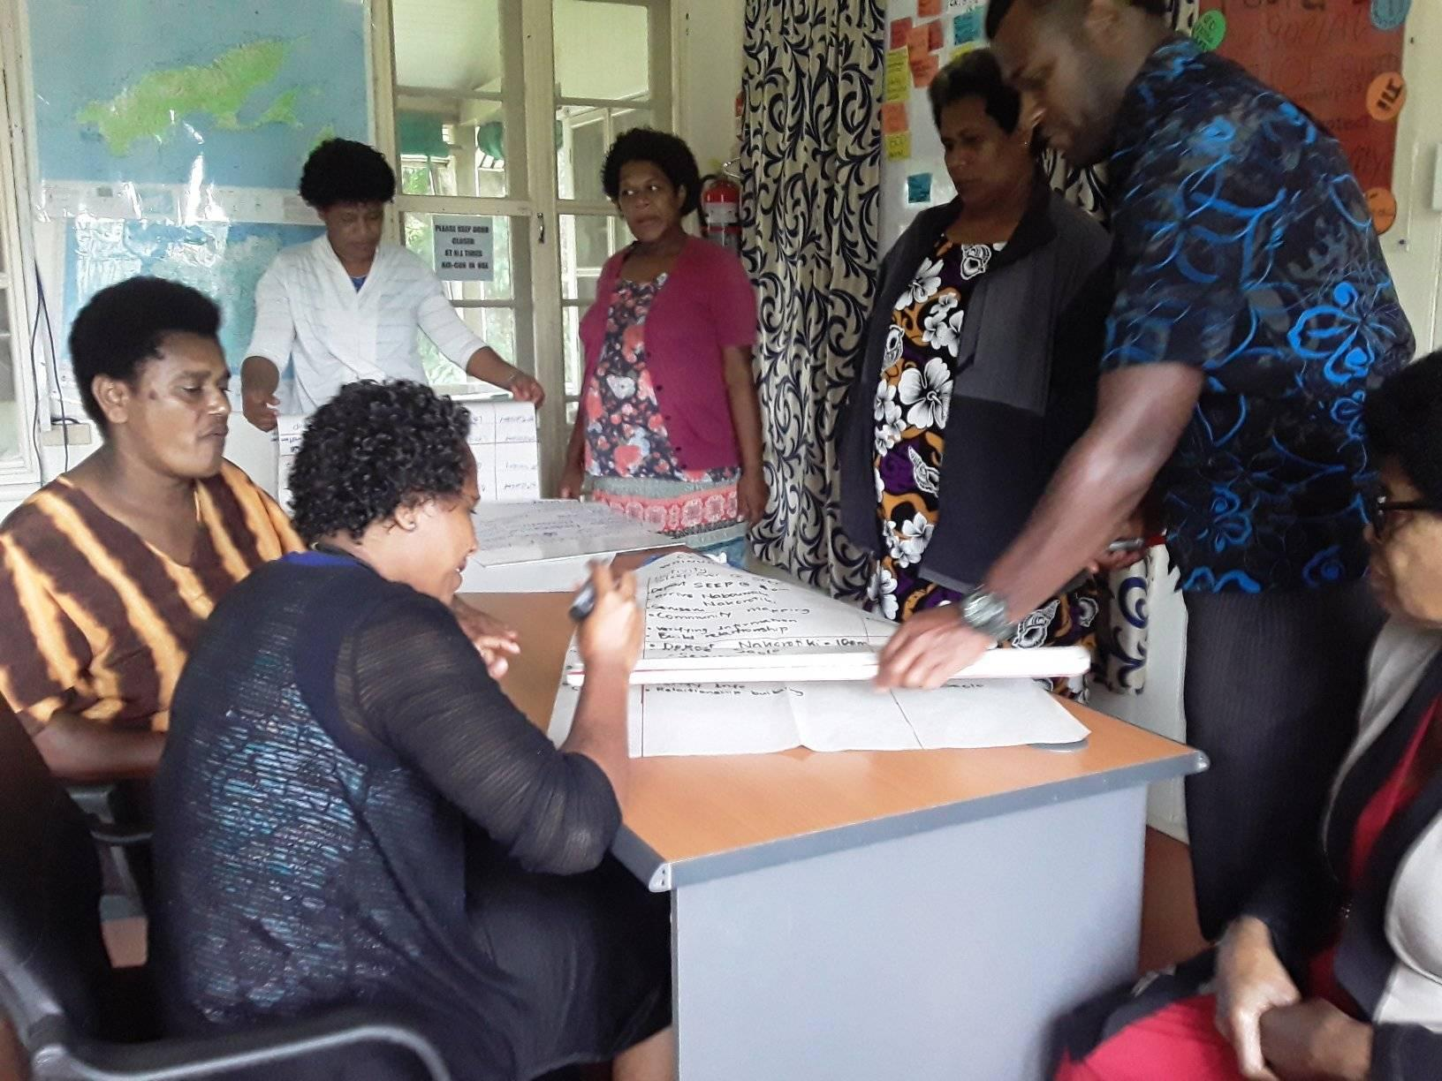
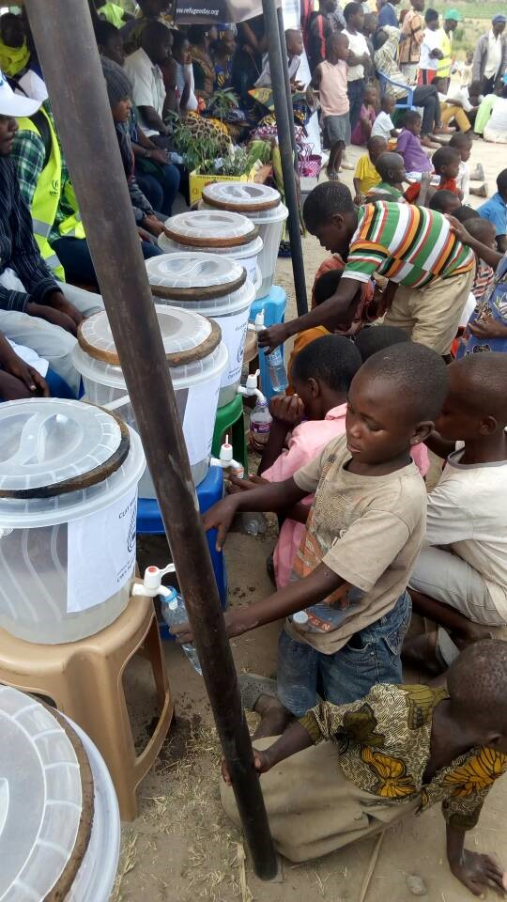
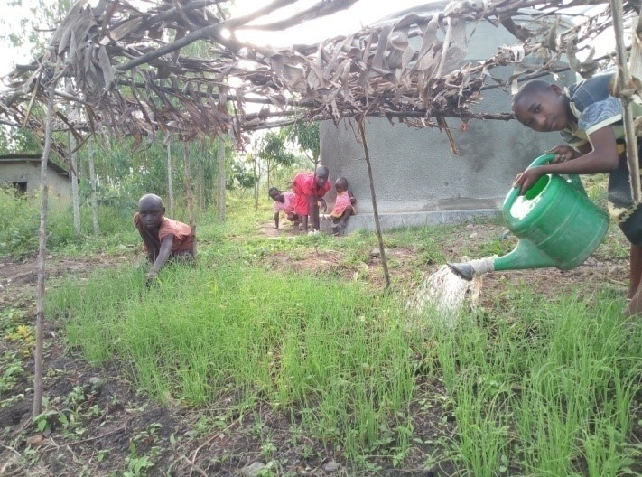
Report Back
Special Project
2017 – 18 Uganda 2018 – 19 Fiji
Notes:
Thank you for working so faithfully to support the Special Project and remembering Christian World Service in your prayers. We value our special relationship with you.
Much has happened in Uganda and in Fiji thanks to your donations and hard work. In 2017-8 you raised $20,095 for rainwater tanks in South Uganda. It was enough to pay for half of 54 rainwater tanks, the rest is paid for by the caregiver of the children orphaned by HIV and AIDS. The Centre for Community Solidarity is most grateful for your hard work. Now with rainwater tanks, the children will be clean and able to go to school. Instead of spending hours each day on trips to collect water, they have more time to help in the family garden and do other chores. The families value your support that makes this possible.
You have just completed your fundraising efforts for SEEP, the Social Empowerment Education Programme in Fiji. On July 1, they began a new cycle of work with some initial funding from CWS. The newly trained Community Graduates and Community Facilitators have begun visiting the 36 communities with whom they will work in the coming years. They have spent two weeks in Bua, Tailevu and Naitasiri developing community profiles and maps. It is early days yet.

Slide 2
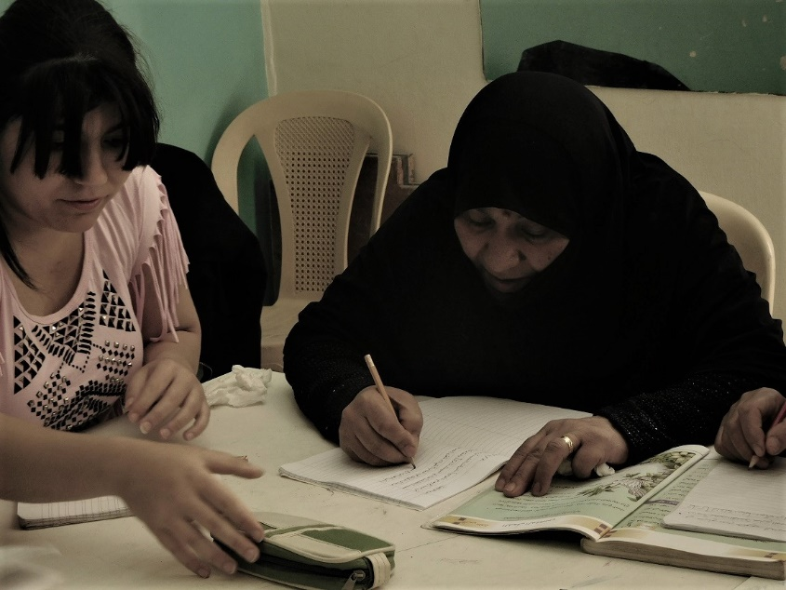
Chosen People called to proclaim Life and hope for women and children
2019 - 20
Notes:
This year the Special Project is raising funds for the Department of Service to Palestinian Refugees’ work with women and children. In 1948, an estimated 700,000 Palestinians fled or were forced from their homes when Israel declared independence. They look back and call the time Nakba or catastrophe.
Local churches gave help, expecting it to be for a short time. Instead they have never been able to return home. Many of the older Palestinians remember times when they lived in villages together as Christians, Muslims and Jews. The population has grown and now more than 5 million are refugees. DSPR grew out of the work the churches began. They have made education, medical care and support for their people – Christian and Muslim. They are well respected for the work they do.
The women pictured are learning to read and write. Girls and women young and old sit side by side. The parents of the young Palestinian women on the left kept her home from school for the last five years concerned for her safety. The programme run by DSPR has opened new opportunities for them – something that makes them very happy.
The region has changed a lot since the Bible was written, but there is much that is familiar – places like Bethlehem and Nazareth, Jerusalem and the Jordan river.

Slide 3
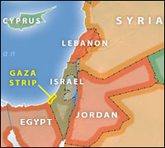
Notes:
Making links with Palestine
Ask if anyone has visited Palestine, Israel, Jordan or Lebanon. Perhaps someone can describe what they saw. Alternatively, you could invite people to name familiar places.
DSPR works through local committees in Galilee (working with Arab and Palestinian displaced people), Gaza, Lebanon, Jordan and the West Bank.
It is important to remember there have been Christians living there since the time of Jesus. Their voice is not always heard, and they like all Palestinians have been facing more discrimination under Israeli Occupation.
However, 10 years ago, they gathered to write a document they called Kairos Palestine. They asked the international community to stand with them:
“We proclaim our word based on our Christian faith and our sense of Palestinian belonging – a word of faith, hope and love.
We declare that the military occupation of Palestinian land constitutes a sin against God and humanity. Any theology that legitimizes the occupation and justifies crimes perpetrated against the Palestinian people lies far from Christian teachings.
We urge the international community to stand with the Palestinian people in their struggle against oppression, displacement, and apartheid.”

Slide 4
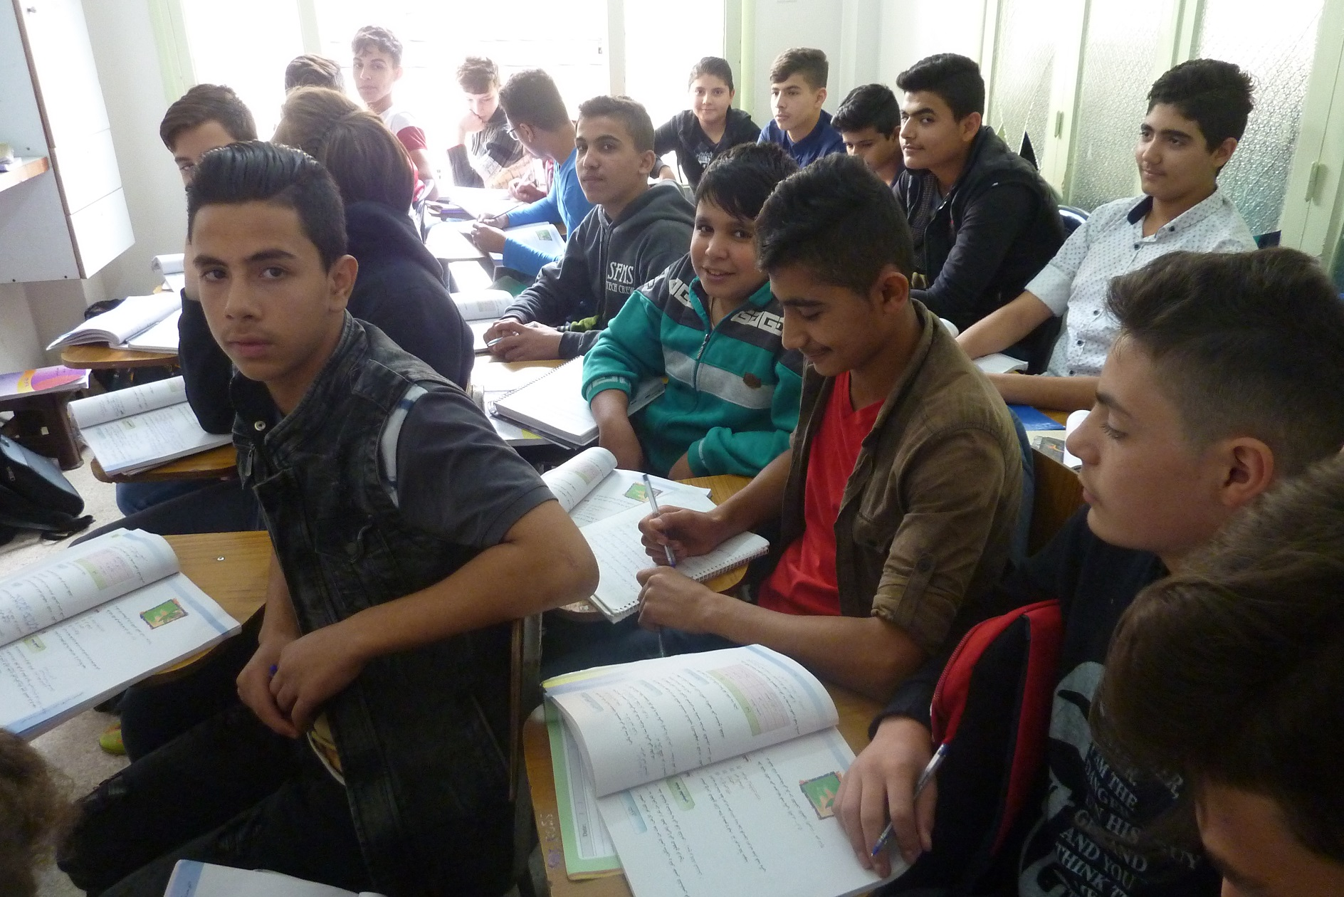
Notes:
Since the arrival of refugees from Syria, some of whom are Palestinian and therefore double refugees, there has been more demand for DSPR’s programmes. They have been able to use the skills they have learnt and the networks they have built to assist the refugees in Jordan and Lebanon. With your help CWS has been able to assist with funding for emergency assistance, education, medical care, and training to improve income. The DSPR committees have stretched the resources they have to assist them over the long eight years of the war in Syria.
In Lebanon, they run a preschool, tutoring programmes through to high school, including for students who have dropped out and following the Syrian curriculum.
One of the students was Omar (pictured left) who had been thrown out of school for laziness and bad behaviour. His father brought him to DSPR Lebanon and asked to enrol him in a vocational training programme. The director told them that he would have to change his behaviour before he could join anything. Under the guidance of the teachers in the drop out programme, he started to understand the lessons and learn how to think. His behaviour improved and he asked to return to his old school. The teachers could not believe his transformation. He is now doing well.

Slide 5
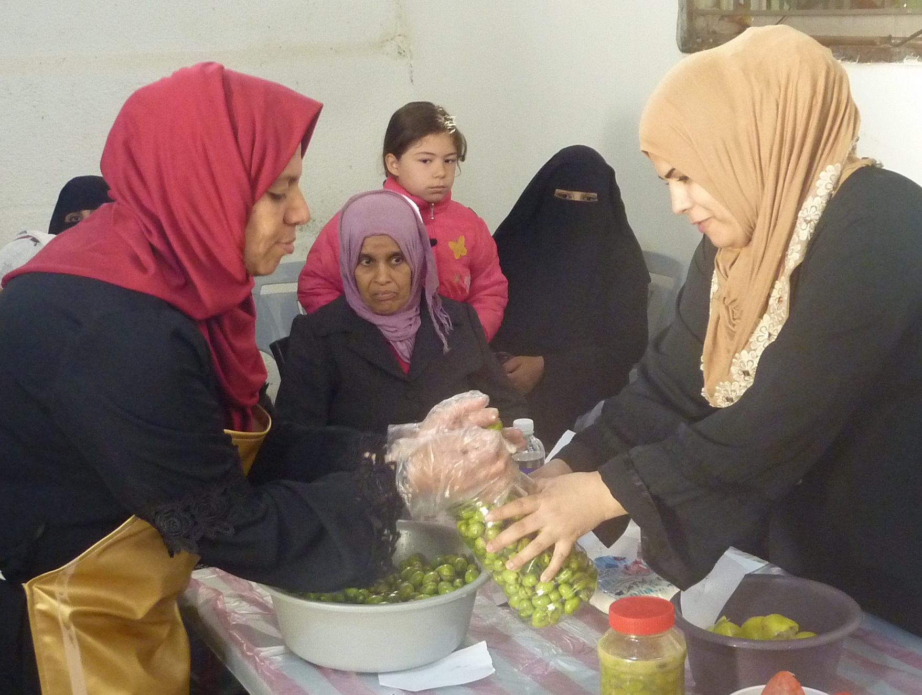
Notes:
Many of the refugee women have lost husbands in the war or they have stayed behind in Syria. Their savings have long gone and the women find themselves responsible for caring for older relatives and children with few resources. The support groups for mothers have been a huge help but so has the opportunity to learn business skills and access micro credit. Selling olives and pickles or making other food products is one way they can earn some extra funding.

Slide 6
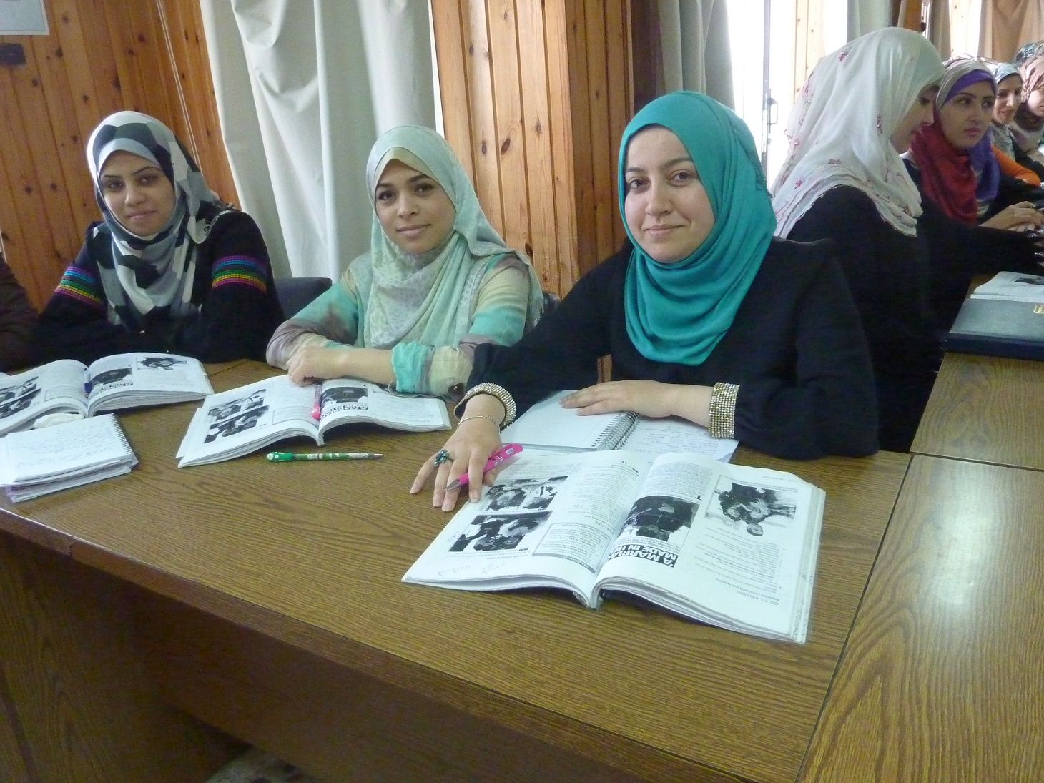
Notes:
Young women are glad of the chance to learn skills.
There are very limited employment opportunities for Palestinian and Syrian refugees – as governments try to keep the jobs for their own citizens. The refugees credit DSPR for helping them gain confidence and find the support to provide extra income for their families who are almost totally dependent on the United Nations and other agencies for food and other necessities. DSPR has helped many young women into employment through their vocational programmes. They run sewing, hairdressing and secretarial courses in Jordan, Lebanon and Gaza. Young men prefer to work on computers and electricity or mechanics . Graduates have a very good employment rate and the training gives young people an opportunity to contribute to family income which is a source of great pride when unemployment reached 52% in Gaza last year.

Slide 7
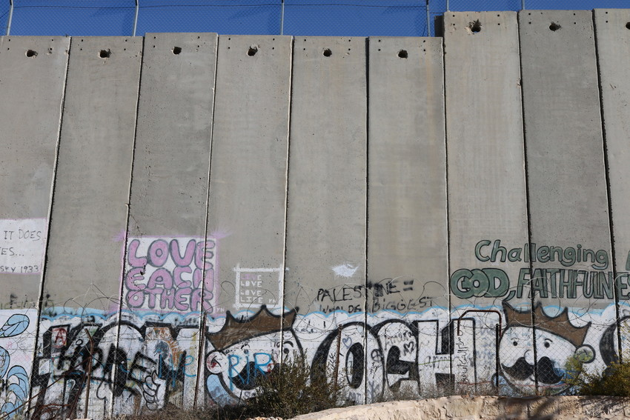
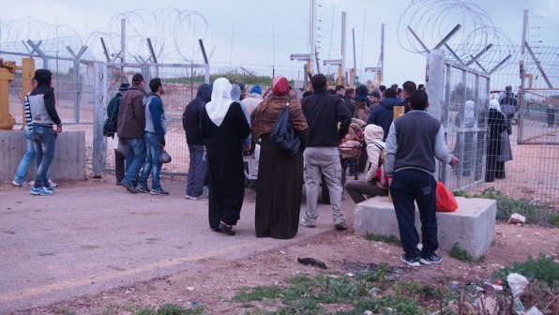
Notes:
Palestinians confront the Occupation by Israel on a daily basis. Military checkpoints are common and can be closed at short notice, leaving families split or unable to go home. Gaza has not been rebuilt after the 2014 war. Israel controls the borders and allows only limited construction materials into the territory.
The occupation breeds despair and violence especially among young people who can resort to stone throwing. At any one time up to 700 children under the age of 18 are held in Israeli jails. They grow up living with a strong military presence and no opportunities. The Israeli military regularly patrol the countryside and undertake significant manoeuvres.
Israel controls the borders, the water supply and electricity. The new Israeli settlements use more of these resources and are connected by roads that cut through Palestinian settlements. The security wall built by Israel has cut off people from their homes and land. It surrounds Bethlehem on three sides.

Slide 8
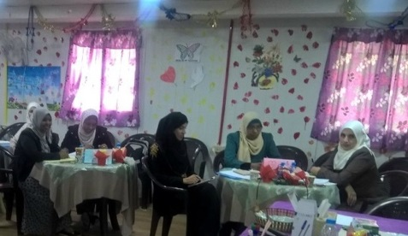
Notes:
For two years, Shireen (pictured right) has worked as a volunteer with DSPR Jordan. She welcomes the chance to get out of her tiny apartment and meet with other women, something she would not have done back home in Syria. She says for her it is better than the 1,000 pills prescribed by the psychiatric clinic she attended when she first arrived in Irbid, a city close to the border with Syria.
One of the programmes DSPR runs in Jordan is a network of support groups for mothers. Leaders like Shireen are trained to support their members, collect data and report any pressing needs to DSPR for further help. Shirren passes on what she has learnt to her group – lessons about health, how to improve livelihoods or community issues like gender based violence. In Syria, she spent her days at home caring for her family, so the biggest challenge has been to find the courage to speak in front of others.
Shireen’s story is not an easy one. In 2015 with her four children she fled Dar’a, where Syria’s uprising first began seven years ago.
"Since I came to Jordan, I was in trauma because of the death of my husband, where he was killed in front of my eyes. It forced me to be a regular visitor to the psychiatric clinic for a long period of time," she says.
A strong woman, Shireen has found new purpose in her role as group leader with new responsibilities outside her home. She is not sure what the future holds for her homeland. However, her bottom line will always be her own children – she is determined that they will keep up their schooling as she knows this is the best investment for the future.

Slide 9
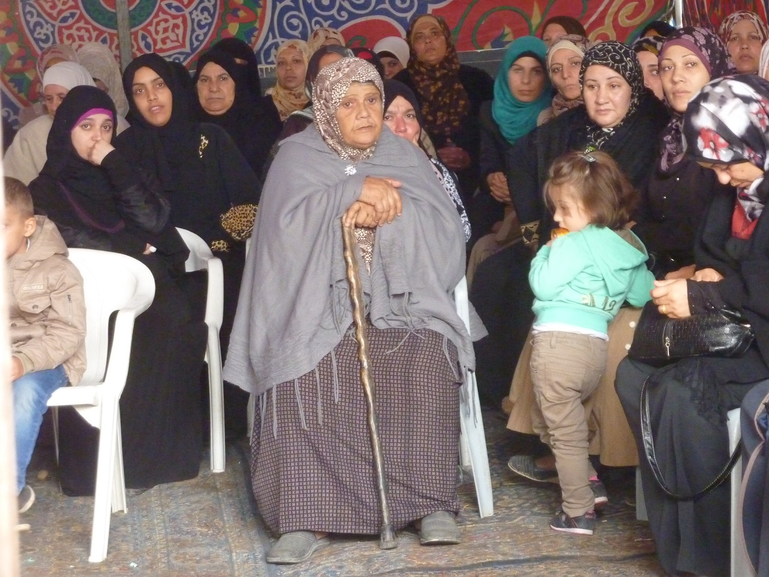
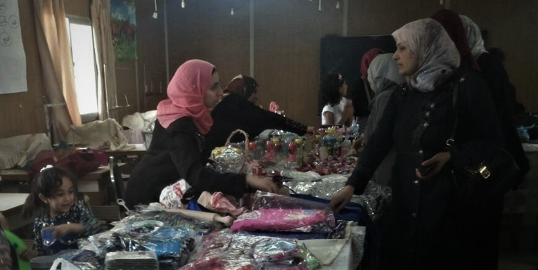
Notes:
DSPR makes spaces for women to come together. They have trained trainers who in turn train leaders of women’s groups. The women can share knowledge and experiences. Those from Syria learn how to adapt to their new environment.
In these groups they have been able to promote education for girls to discourage families from marrying young women as young as 12 or 13 as a response to the shortage of food and money.
By working with Palestinian and Syrian refugee women together, DSPR has helped manage tensions that often arise between refugees and host communities. Your support has been a lifeline to them.

Slide 10
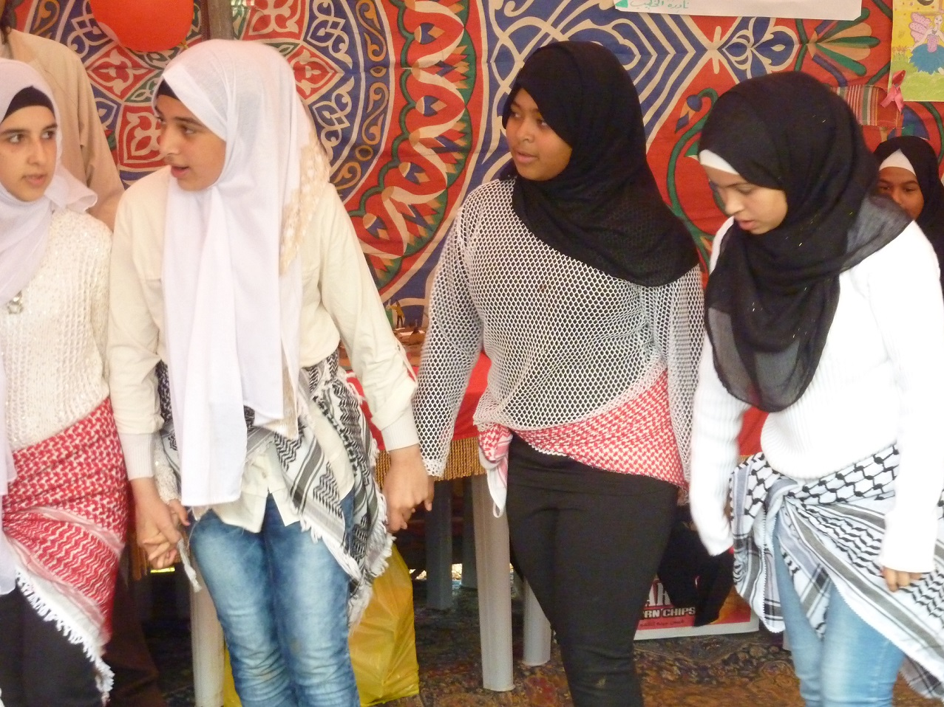
Notes:
DSPR encourages families to pass on their cultural traditions. They hold fun days and summer camps where the children can escape their crowded homes and learn the songs and dances of their community. Every refugee has a story of the home their parents and grandparents left behind. Some of them have the keys to the homes they left in 1948. Your support will give them more opportunities to pass on these traditions, have better healthcare and the chance to earn income. Most important of all your support will mean DSPR can work to restore their confidence and dignity.

Slide 11
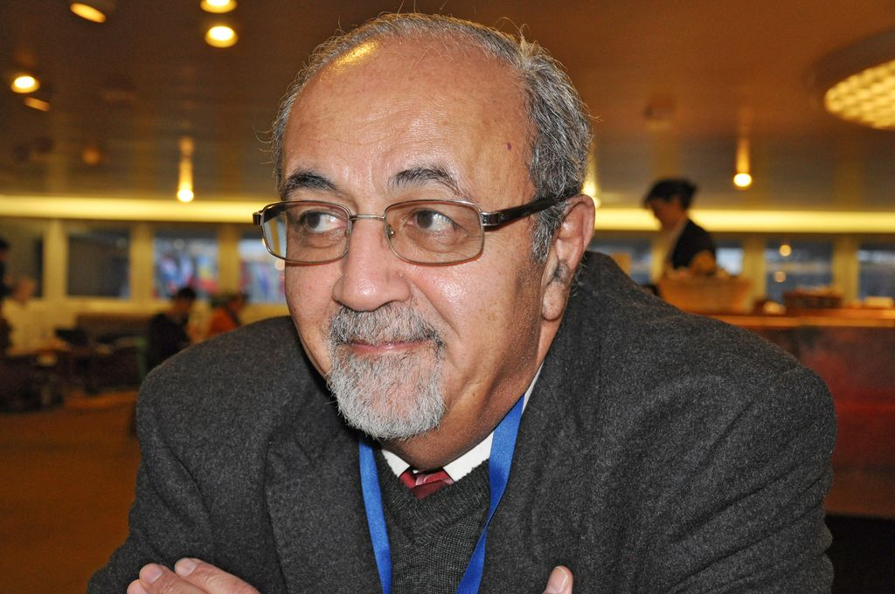
Thank you for supporting the Special Project
2019 - 20
Notes:
“Although you all are at the furthest distance from the Holy Land, yet your caring, prayers and overall support have always been with us in the Department of Service to Palestinian Refugees of the Middle East Council of Churches. In particular the generosity and solidarity you have shown to Palestinian women and young people gets reflected in activities of immediate relief, psychosocial support, planning for economic self-support with a small business, networking among the women here in order that they cope better with the different and difficult challenges facing them, their youngsters and their community. This all would not have been possible without your support and each one of the Methodist and Presbyterian women in New Zealand intent on making a difference in our world.
We feel that difference and I am sure I speak on behalf of our women and young people when I send you a BIG THANK YOU each and every one of you. May you be blessed.”
Dr. Bernard Sabella, Executive Secretary DSPR Central Office, Jerusalem
Invite your church and the wider community to support this important programme.
Thank you Christian World Service.

